Slide 1




KJSIT-IET INTECH 2K23 National Level Poster cum Project Competition
Academic Year 2022-23
Identification of Leukemia from Microscopic Images using CNN
Burhanuddin Dilshad
Viraj Gholap
Mehul Prajapati
(Fourth Year Engineering)

Slide 2
Outline of Presentation
Introduction
Summary / Finding of Literature Survey
System Design & Architecture
Proposed Methodology( Algorithm / Flowchart etc)
Video & Audio demonstration of Running Project(5Mins)
Results
Conclusion
References
KJSIT-IET INTECH 2K23 National Level Poster cum Project Competition

Slide 3
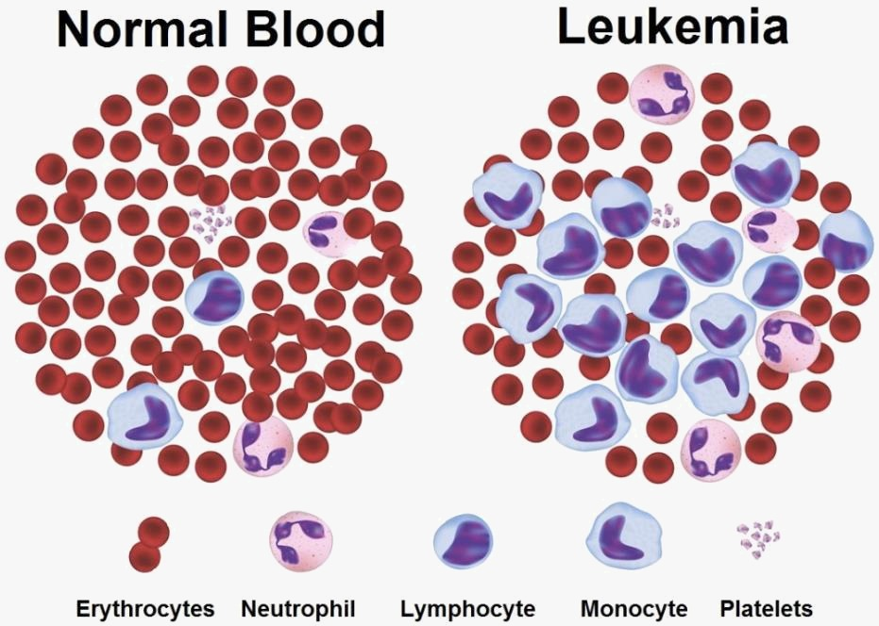
Introduction
Blood consists of plasma, and three different types of cells and they are: White Blood Cells, Red Blood Cells and Platelets and each of these performs particular task
Leukemia is cancer of blood cells in which number of white cells is increases numerously and those are immature cells that interfere with other blood cells.
KJSIT-IET INTECH 2K23 National Level Poster cum Project Competition

Slide 4
Summary / Finding of Literature Survey
Papers | Authors | Key Findings
1) Machine Learning in Detection and Classification of Leukemia Using Smear Blood Images: A Systematic Review. | Mustafa Ghaderzadeh,Farkhondeh Asadi,Azamossadat Hosseini | This review study presents the average accuracy of the ML methods applied in PBS image analysis to detect leukemia indicating that the use of ML could lead to extraordinary outcomes in leukemia detection from PBS images. Among all ML techniques, deep learning (DL) achieved higher precision and sensitivity in detecting different cases of leukemia.
2) Leukemia detection Mechanism through microscopic images and ML techniques | Mohammad Akter Hossain; Mubtasim Islam Sabik; Ikramuzzaman Muntasir | In this paper Faster-RCNN machine learning algorithm is used to predict the odds of cancer cells forming.
KJSIT-IET INTECH 2K23 National Level Poster cum Project Competition

Slide 5
Summary / Finding of Literature Survey
Papers | Authors | Key Findings
3) Automated Detection of Acute Lymphotic Leukemia using Blast Cell Morphological features. | S. Hariprasath, T. Dharani, Bilal N Shaikh Mohammad | In this study, authors propose a novel combination of techniques to overcome the most challenging parts of the detection process and present detailed insights into the greatest shortcomings of the existing classification methodologies
4) Automated decision support system for detection of Leukemia from Peripheral blood smear images. | Iqbal H. Sarker | In this study, SVM classifier was used for classification of white blood cells into normal and abnormal, and also for detection of leukemic WBCs from the abnormal class. Classification of the normal white blood cells into five sub-types was performed using CNN classifier. Overall classification accuracy of 91.8% was obtained using the combination of CNN and SVM.
KJSIT-IET INTECH 2K23 National Level Poster cum Project Competition

Slide 6
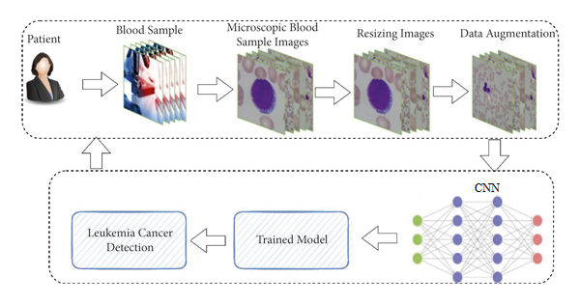
System Design & Architecture
KJSIT-IET INTECH 2K23 National Level Poster cum Project Competition

Slide 7
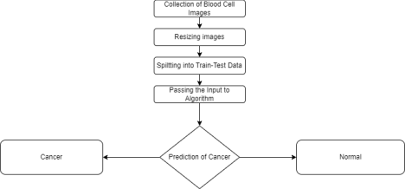
Proposed Methodology (Flowchart)
KJSIT-IET INTECH 2K23 National Level Poster cum Project Competition

Slide 8

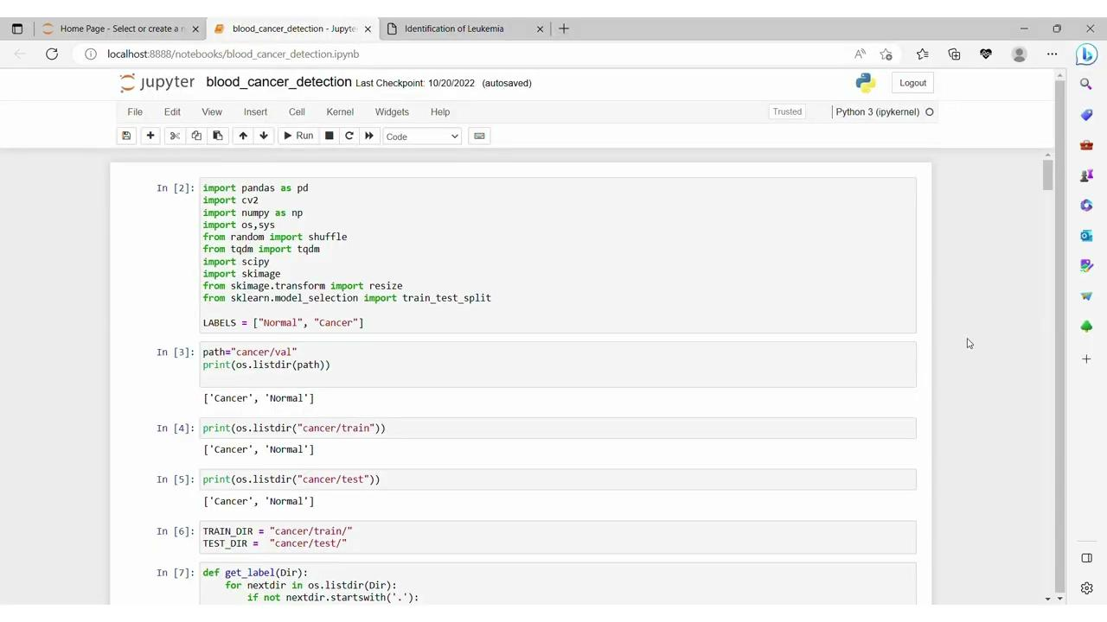
Video & Audio demonstration of Running Project(5Mins)
KJSIT-IET INTECH 2K23 National Level Poster cum Project Competition

Slide 9
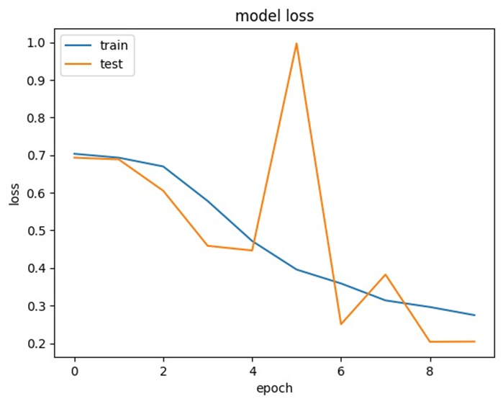
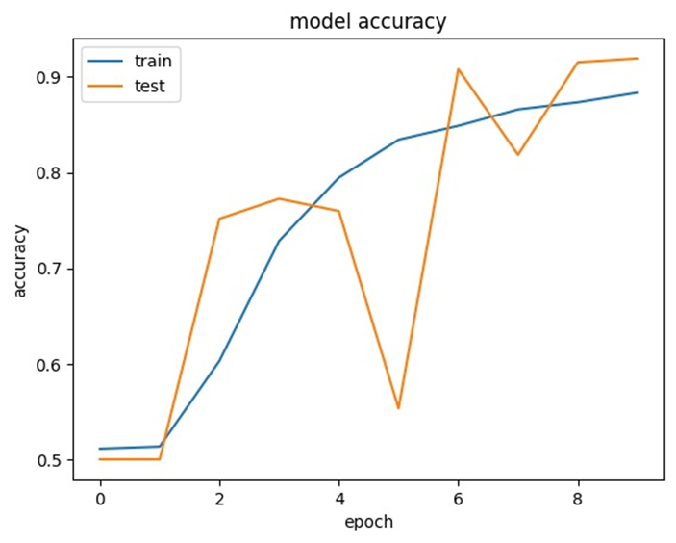
Results
KJSIT-IET INTECH 2K23 National Level Poster cum Project Competition

Slide 10
Conclusion
Since Leukemia is a rapidly spreading disease, traditional techniques of cancer detection need a lot of time-consuming transport of sample tissue (biopsy) to a facility for cancer diagnosis.
Yet, early cancer treatment is likely to boost the chances of survival for cancer patients. Results obtained with the aid of machine learning are quick and precise, aiding in early diagnosis and enabling low-cost treatment.
KJSIT-IET INTECH 2K23 National Level Poster cum Project Competition

Slide 11
References
Chaitali R., and Jyoti Rangole, “Detection of Leukemia in microscopic images
S. Mohapatra, D. Patra, and S. Satpathy, “Unsupervised blood microscopic image segmentation and unsupervised blood microscopic image segmentation and leukemia detection using color based clustering,” International Journal of Computer Information Systems and Industrial Management Applications, vol. 4, pp. 477–485, 2012.
J. Zhao, M. Zhang, Z. Zhou, J. Chu, and F. Cao, “Automatic detection and classification of leukocytes using convolutional neural networks,” Medical & Biological Engineering & Computing, vol. 55, no. 8, pp. 1287–1301, 2016.
G. Litjens, C. I. Sánchez, N. Timofeeva et al., “Deep learning as a tool for increased accuracy and efficiency of histopathological diagnosis,” Scientific Reports, vol. 6, no. 1, 2016.
KJSIT-IET INTECH 2K23 National Level Poster cum Project Competition

